Slide 1
影像處理、電腦視覺及深度學習概論 (Introduction to Image Processing, Computer Vision and Deep Learning) Homework 2
TA:
彥博: nckubot65904@gmail.com
Office Hour: 17:00~19:00, Mon.
10:00~12:00, Fri.
At CSIE 9F Robotics Lab.

Slide 2
Notice (1/2)
Copying homework is strictly prohibited!! Penalty: Grade will be zero for both persons!!
If the code can’t run, you can come to our Lab within one week and show that your programming can work. Otherwise you will get zero!!
Due date => Midnight 23:59:59 on 2021/12/26 (Sun.)
No delay. If you submit homework after deadline, you will get 0.
Upload to => 140.116.154.1 -> Upload/Homework/Hw2
User ID: opencvdl2021 Password: opencvdl2021
Format
Filename: Hw2_StudentID_Name_Version.rar
Ex: Hw2_F71234567_林小明_v1.rar
If you want to update your file, you should update your version to be v2, ex: Hw2_F71234567_林小明_v2.rar
Content: project folder*( including the pictures ) *note: remove your “Debug” folder to reduce file size

Slide 3
Notice (2/2)
Python (recommended)
Python 3.7 (https://www.python.org/downloads/)
opencv-contrib-python (3.4.2.17)
Matplotlib 3.1.1
UI framework: pyqt5 (5.15.1)
C++ (check MFC guide in ftp)
OpenCV 3.3.1 (https://opencv.org/release.html)
Visual Studio 2015 (download from http://www.cc.ncku.edu.tw/download/)
UI framework: MFC

Slide 4
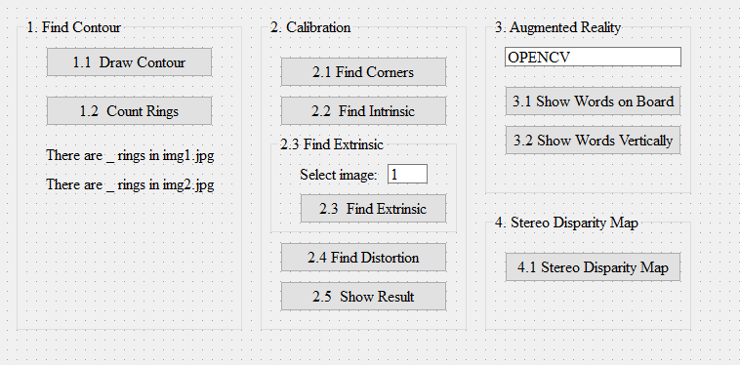
Assignment scoring (Total: 100%)
(20%) Find Contour
1.1 (10%) Draw Contour
1.2 (10%) Count Coins
2. (20%) Camera Calibration
2.1 (4%) Corner detection
2.2 (4%) Find the intrinsic matrix
2.3 (4%) Find the extrinsic matrix
2.4 (4%) Find the distortion matrix
2.5 (4%) Show the undistorted result
3. (20%) Augmented Reality (出題：Keter)
3.1 (10%) Show words on board
3.2 (10%) Show words vertically
4. (20%) Stereo Disparity Map (出題：Aaron)
4.1 (10%) Compute disparity map
4.2 (10%) Checking the Disparity Value
5. (20%) Dogs and Cats classification Using ResNet50 (出題：育成)
(出題：Ray)
UI Example
(出題：West)

Slide 5
1. (20%) Find Contour (出題：Ray)
1.1 (15%) Draw Contour
1.2 (5%) Count Rings

Slide 6
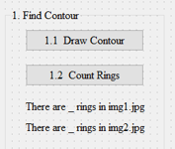
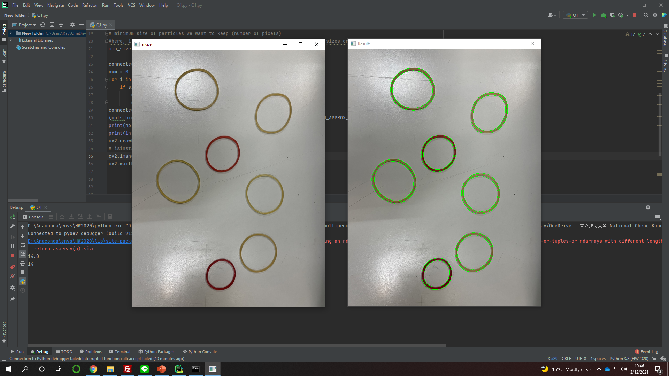
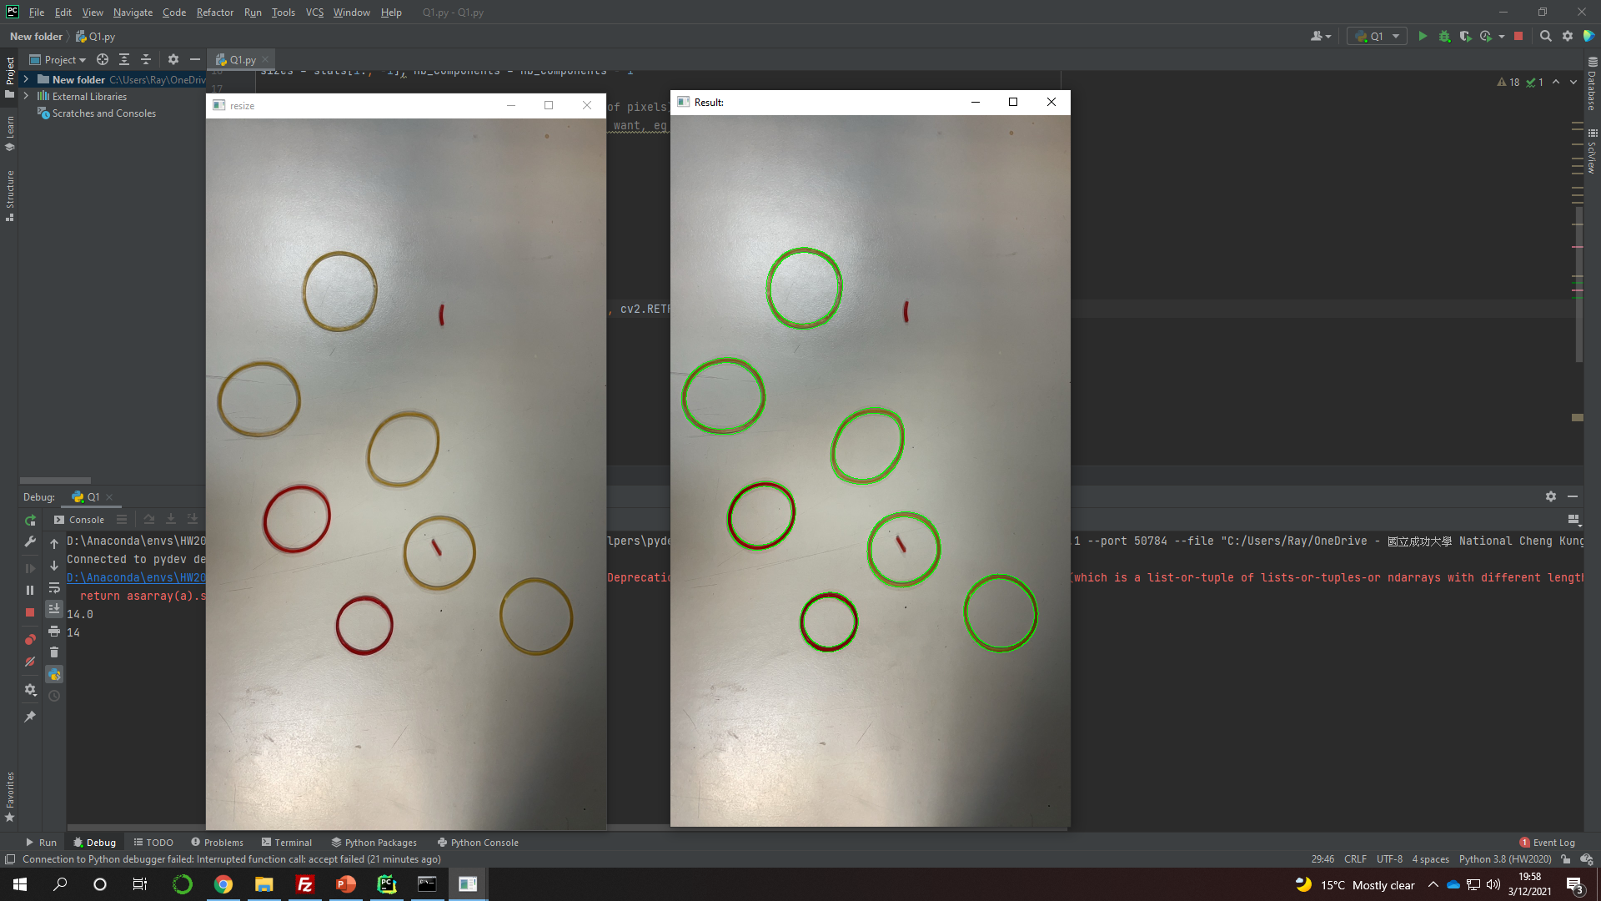
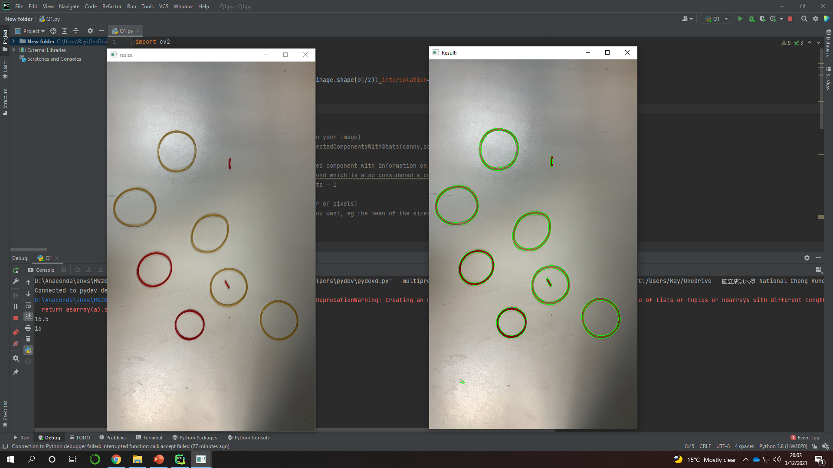
1.1 Find Contour – Draw Contour
Given: two color images, “img1.jpg” and “img2.jpg”
Q: 1)
Hint: Textbook Chapter 8, p.234 ~ p.241
RGB ➔ Resize(1/2) ➔ Grayscale ➔ Binary
Remember to remove the noise. (use Gaussian Blur & other function)
Using some edge detection functions to get better results. (Ex: cv2.Canny)
(出題：Ray)
Draw Contour: Using OpenCV functions to find the contours of rings in two images.
img1.jpg
Draw Contours
img2.jpg
Draw Contours

Slide 7
1.2 Find Contour – Count Rings
(出題：Ray)
Given: two color images, “img1.jpg” and “img2.jpg”
Q: 2)
Hint: Textbook Chapter 8, p.234 ~ p.241
Calculate how many rings (contour/2)
Count Rings: Using OpenCV functions to find how many rings in two images.
7 rings
7 rings
img1.jpg
img2.jpg

Slide 8
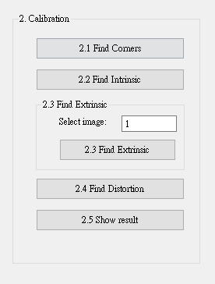
2. (20%) Camera Calibration
(出題：West)
2.1 (4%) Corner detection
2.2 (4%) Find the intrinsic matrix
2.3 (4%) Find the extrinsic matrix
2.4 (4%) Find the distortion matrix
2.5 (4%) Show the undistorted result

Slide 9
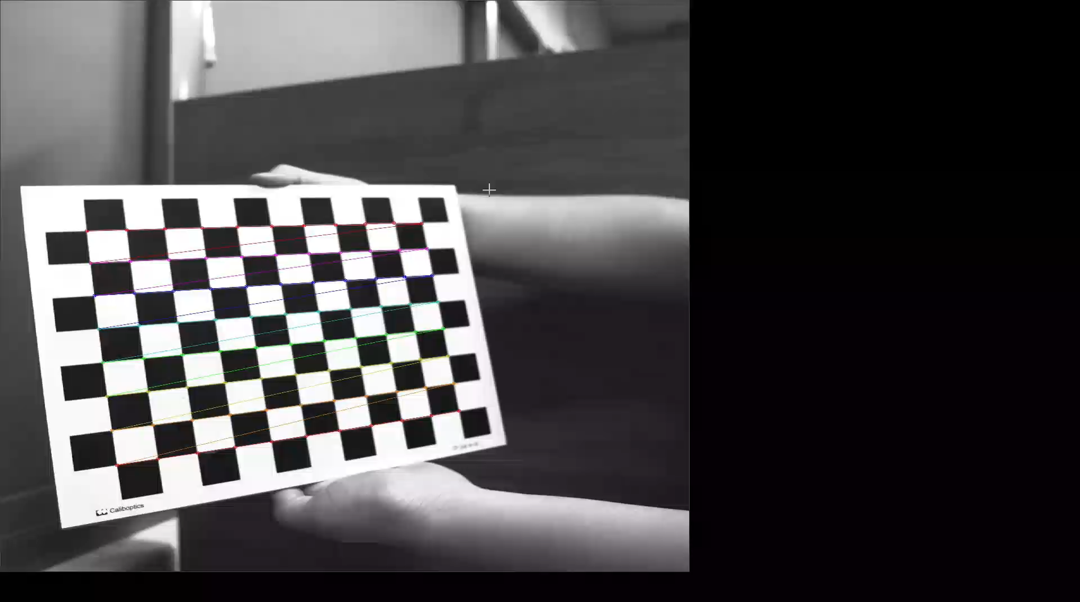
2.1 Corner Detection (4%)
(出題：West)
Given: 15 images, 1.bmp ~ 15.bmp
Q: 1) Find and draw the corners on the chessboard for each image.
2) Click button “2.1” to show each picture 0.5 seconds.
Hint :
OpenCV Textbook Chapter 11 (p. 398 ~ p. 399)
cv.findChessboardCorners(…)
Ex:
9

Slide 10
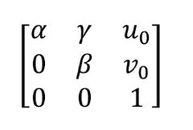
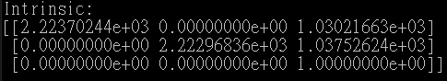
2.2 Find the Intrinsic Matrix (4%)
(出題：West)
Given: 15 images, 1.bmp ~ 15.bmp
Q: 1) Find the intrinsic matrix ():
2) Click button “2.2” and then show the result on the console window.
Output format:
Hint: OpenCV Textbook Chapter 11 (P.398 ~ p.400)
(Just an example)

Slide 11
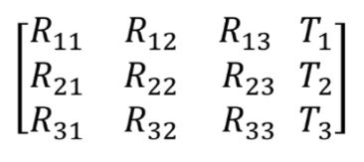
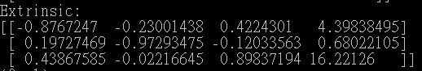
2.3 Find the Extrinsic Matrix (4%)
(出題：West)
Given: Intrinsic parameters, distortion coefficients, and the list of 15 images
Q: 1) Find the extrinsic matrix of the chessboard for each of the 15 images, respectively:
2) Click button “2.3” and then show the result on the console window.
Output format:
Hint: OpenCV Textbook Chapter 11, p.370~402
(Just an example)
(1) List of numbers: 1~15
(2) Select 1, then 1.bmp will be applied, and so on

Slide 12
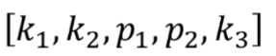
2.4 Find the Distortion Matrix (4%)
(出題：West)
Given: 15 images
Q: 1) Find the distortion matrix:
2) Click button “2.4” to show the result on the console window.
Output format:
Hint:
Distortion coefficients can be obtained simultaneously with intrinsic parameters
OpenCV Textbook Chapter 11 (P.398 ~ p.400)
(Just
an example)

Slide 13
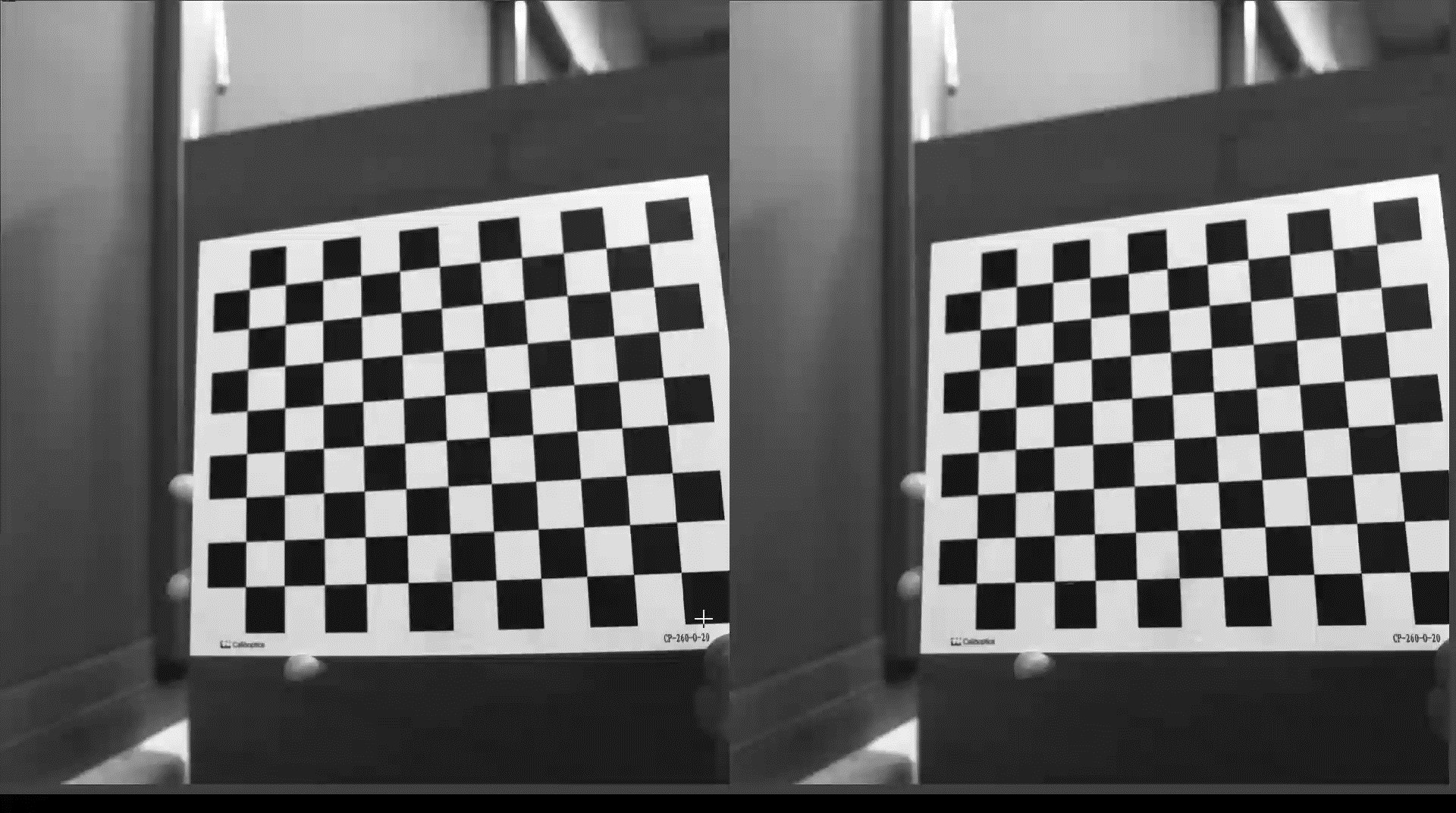
2.5 Show the undistorted result (4%)
(出題：West)
Given: 15 images
Q: 1) Undistort the chessboard images.
2) Show distorted and undistorted images.
Hint:
cv::undistort(…) or cv::initUndistortRectifyMap(…)
OpenCV Textbook Chapter 11 (P.398 ~ p.400)
Distorted image
Undistorted image

Slide 14
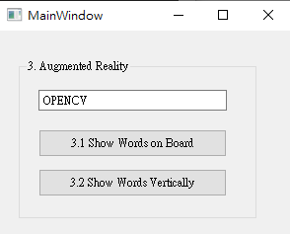
3. (20%) Augmented Reality
(出題：Keter)
3.1 (10%) Show words on board
3.2 (10%) Show words vertically

Slide 15
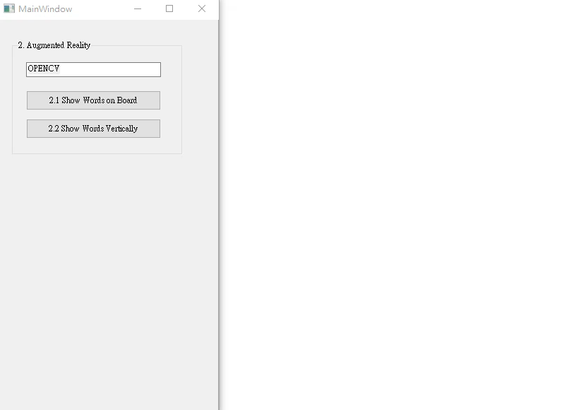
3. (20%) Augmented Reality (出題：Keter)
Given: 5 images: 1~5.bmp
Q:
1) Calibrate 5 images to get intrinsic, distortion and extrinsic parameters
2) Input a “Word” less than 6 char in English in the textEdit box
3) Derive the shape of the “Word” by using the provided library
4) Show the “Word” on the chessboards images(1.bmp to 5.bmp)
5) Show the “Word” vertically on the chessboards images(1.bmp to 5.bmp)
6) Click the button to show the “Word” on the picture. Show each picture for 1 second (total 5 images)
Demo:
Hint : Textbook Chapter 11,
p.387~395 Calibration
p.405~412 Projection
cv2.calibrateCamera()
cv2.projectPoints()

Slide 16
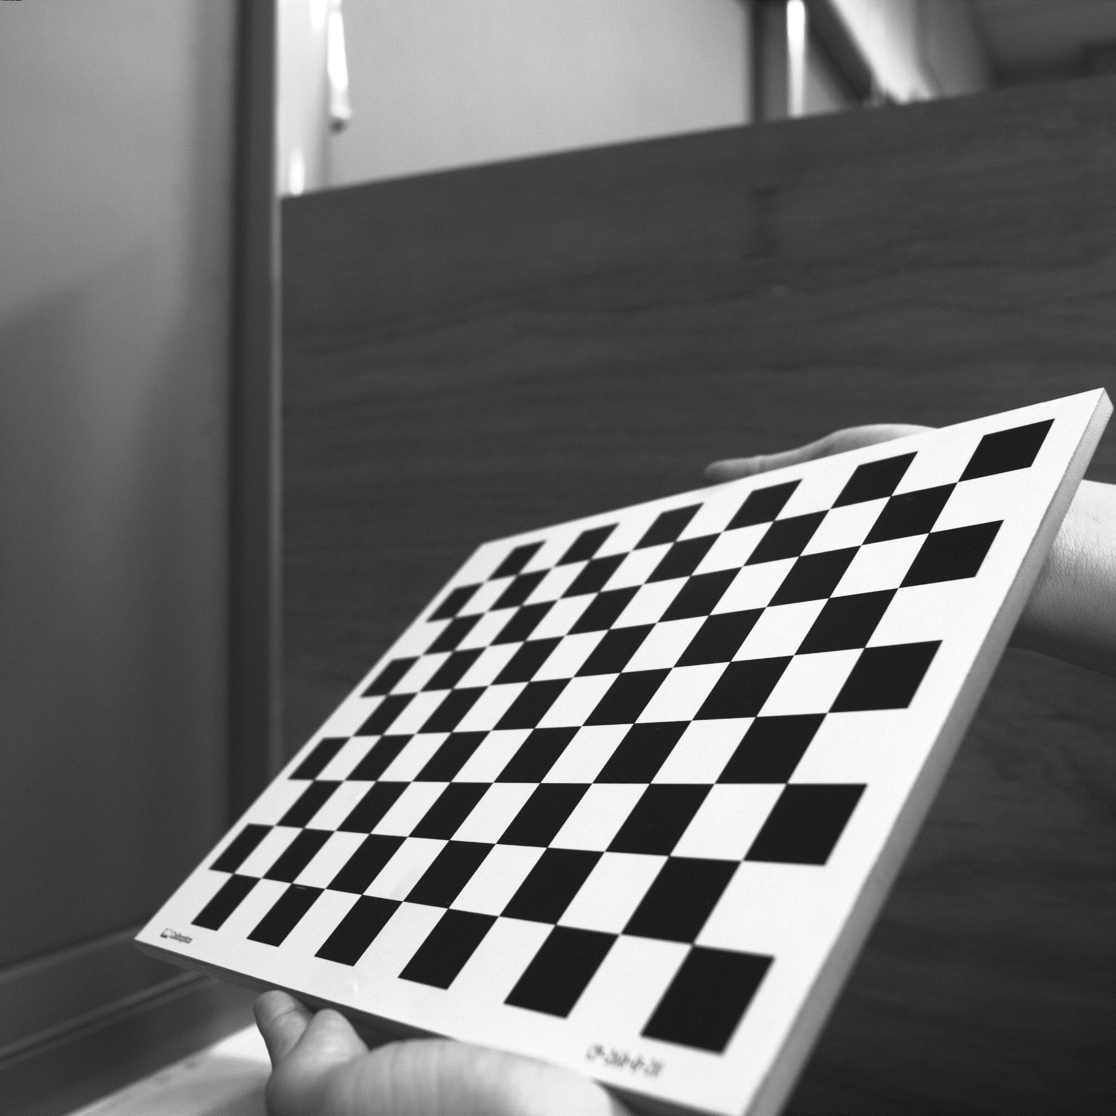
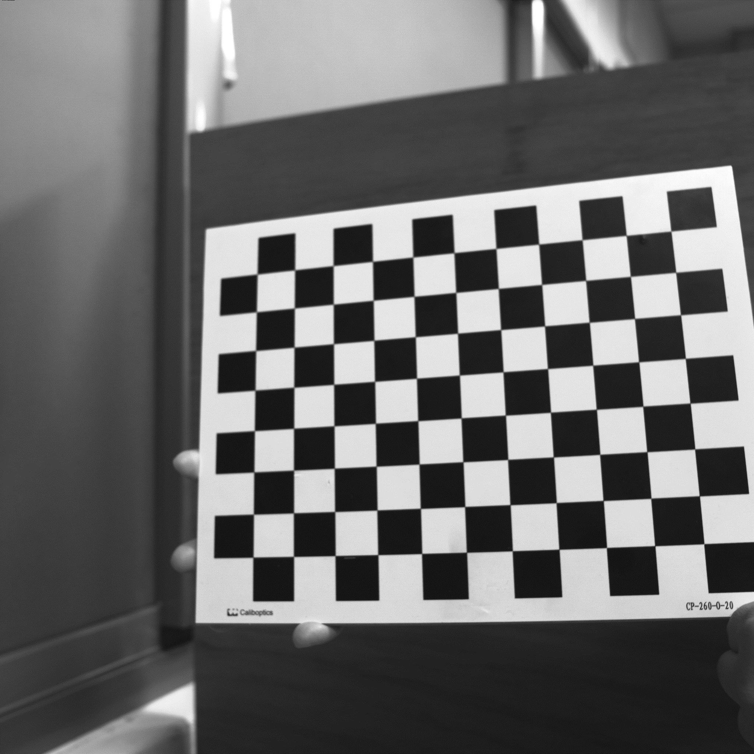
3. (20%) Augmented Reality (出題：Keter)
Guides and Requirements:
How to use the library: (alphabet_lib_onboard.txt, alphabet_lib_vertical.txt)
Use OpenCV function to read and derive the array or matrix of the char Here take ‘K’ in 'alphabet_lib_onboard.txt' for example Ex (Python): fs = cv2.FileStorage('alphabet_lib_onboard.txt', cv2.FILE_STORAGE_READ) ch = fs.getNode(‘K’).mat() ➔ get the lines of ‘K’
ch = [[[2, 2, 0], [2, 0, 0]], [[0, 2, 0], [2, 1, 0]],
[[2, 1, 0], [0, 0, 0]]]
‘K’ consist of 3 lines, so the ‘ch array’ consists 3 pairs of 3D coordinates in Word Frame representing two ends of the line shown in the upper right image.
Chessboard Coordinates
The chessboard x, y, z axis and (0,0,0) coordinate are shown in the bottom left image
Each Char should be place in the order and position shown in the bottom right image
(2,2,0)
(0,2,0)
(2,1,0)
(2,0,0)
(0,0,0)
The coordinates are in Word Frame
(0,0,0)
1
2
3
Y
4
5
6
X
Z
Chessboard Frame
Position and Order

Slide 17
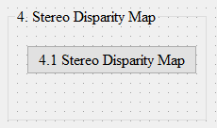
4. (20%) Stereo Disparity Map
(出題：Aaron)
4.1 (10%) Stereo Disparity Map
4.2 (10%) Checking the Disparity Value

Slide 18
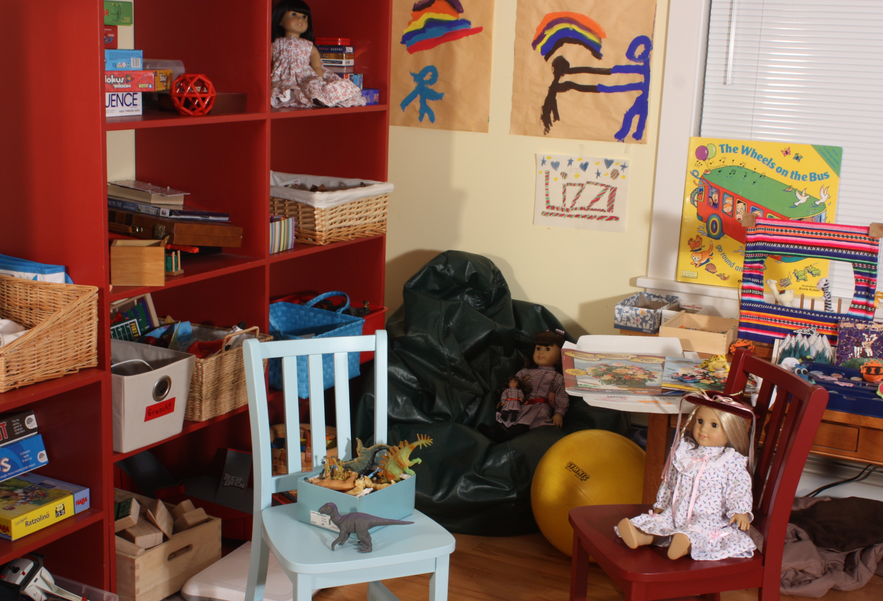
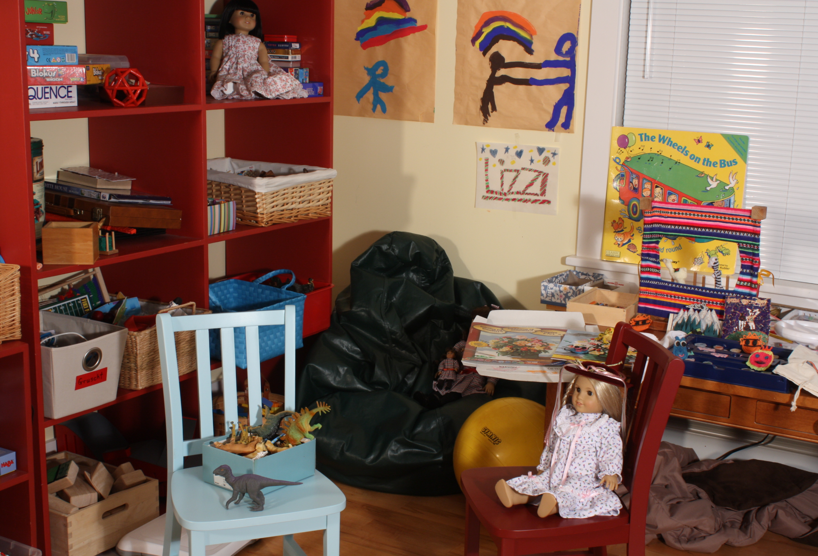
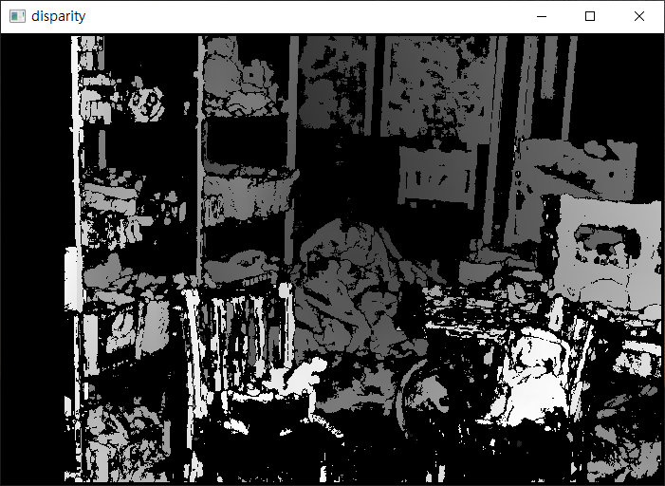
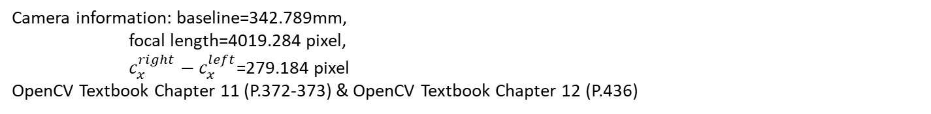
4.1 (10%) Stereo Disparity Map (出題：Aaron)
Given: a pair of images, imL.png and imR.png (have been rectified)
Q:
Find the disparity map/image based on Left and Right stereo images
Guides:
(1) Window Size: Must be odd and within the range [5, 255]
(2) Search range and direction:
Disparity range:
Must be positive and divisible by 16.
Map disparity range to gray value range 0~255 for the purpose of visualization.
If the left image is the reference image (the one used to cal. depth info for each pixel of that img), then the search direction at right image will go from the right to left direction.
Hint: OpenCV Textbook Chapter 12 (P.451)
StereoBM::create(256, 25)
Camera information: baseline=342.789mm,
focal length=4019.284 pixel,
$c_{x}^{right}−c_{x}^{left}$=279.184 pixel
OpenCV Textbook Chapter 11 (P.372-373) & OpenCV Textbook Chapter 12 (P.436)
imL.png
imR.png
Result
Left Image (Reference Image)
Right Image

Slide 19
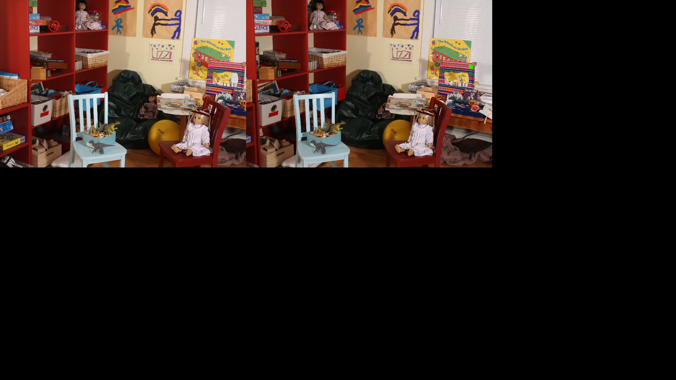
4.2 (10%) Checking the Disparity Value
(出題：Aaron)
Given: a pair of images, imL.png and imR.png and disparity map from Q4.1.
Q:
Click at left image and draw the corresponding dot at right image.
1) Click at left image and draw the dot on the right image at accurate position.
2) User should allow to repeat 1).
Note: Click at gray position at disparity map result from Q.4.1, ignore the position with 0 disparity(e.g. Failure case).
Result

Slide 20
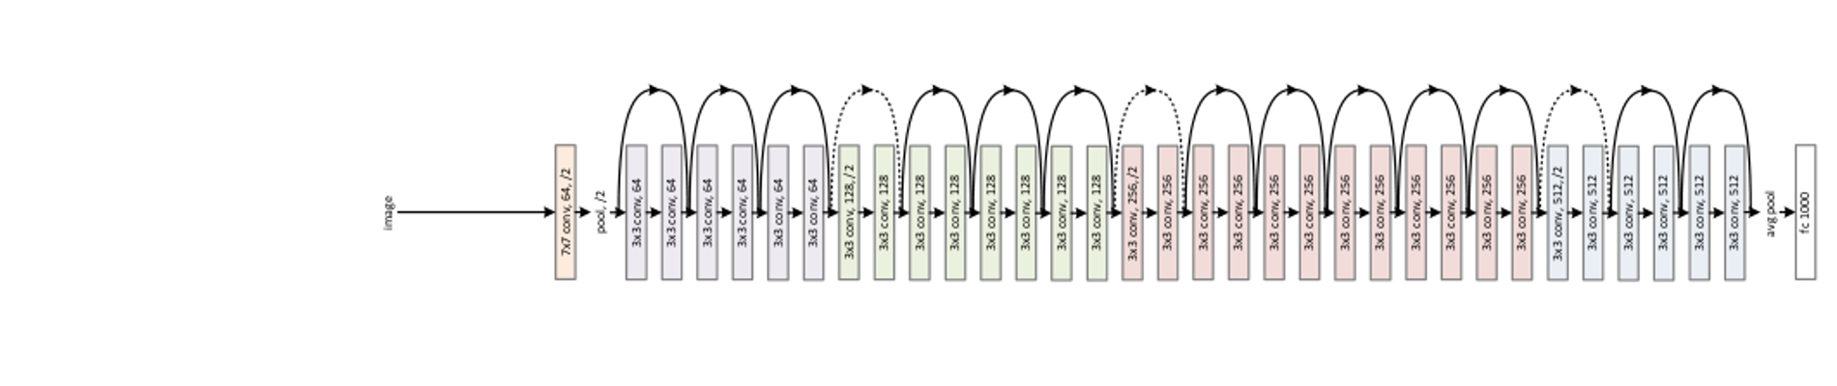
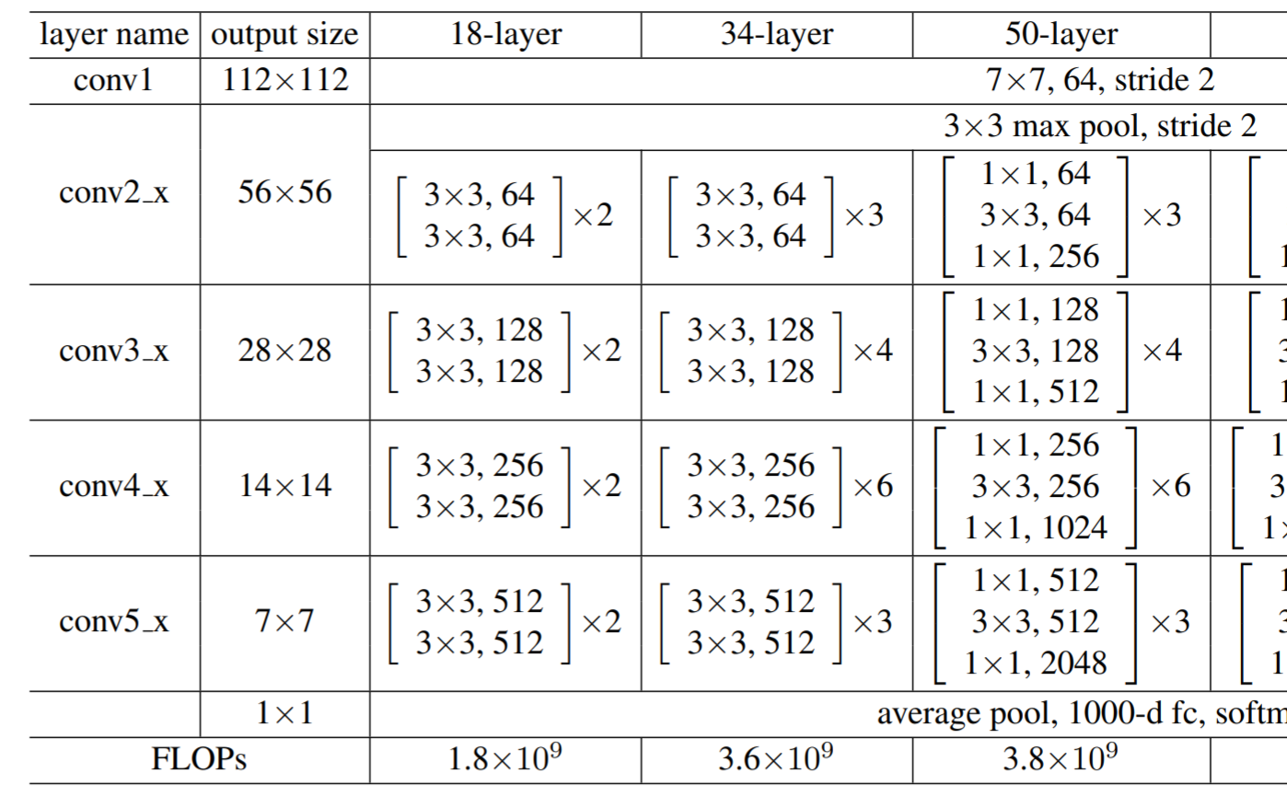
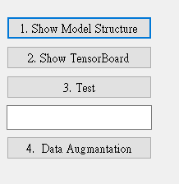
5.0 (20%)Dogs and Cats classification Using ResNet50 (出題：育成)
1) Dataset introduction:
ASIRRA (Animal Species Image Recognition for Restricting Access) is a HIP(Human Interactive Proof) that works by asking users to identify photographs of cats and dogs, that's supposed to be easy for people to solve, but difficult for computers. Now we can use artificial intelligence technology to achieve this goal.
(2) The dataset includes 12501 photos of cats and 12501 photos of dogs. You need to download them in Reference below(R2), and split the training set, validation set and test set using 8:1:1 ratio in both dogs and cats directory.
2) Environment Requirement
(1) Python
(2) Tensorflow
(3) Opencv-contrib-python
(4) Matplotlib
Fig. Example UI
Fig. ResNet’s Network Architecture
R. Reference
R1) Deep Residual Learning for Image Recognition
R2) https://www.microsoft.com/en-us/download/details.aspx?id=54765 (ASIRRA)
Fig. ResNet50's Schematic Diagram

Slide 21
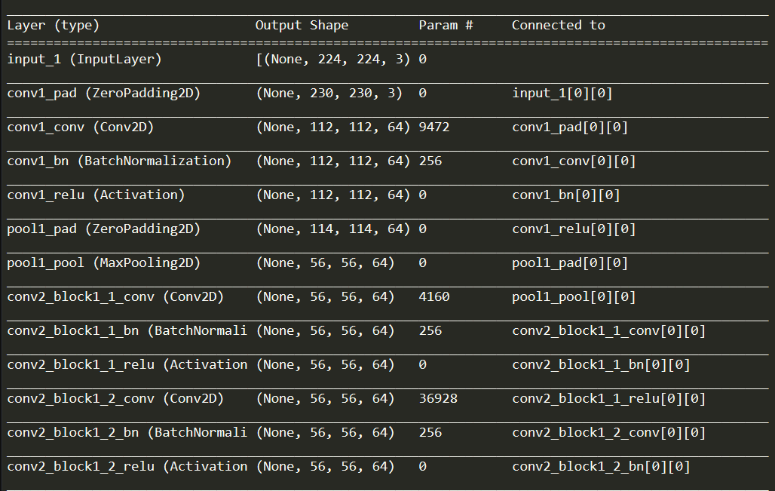
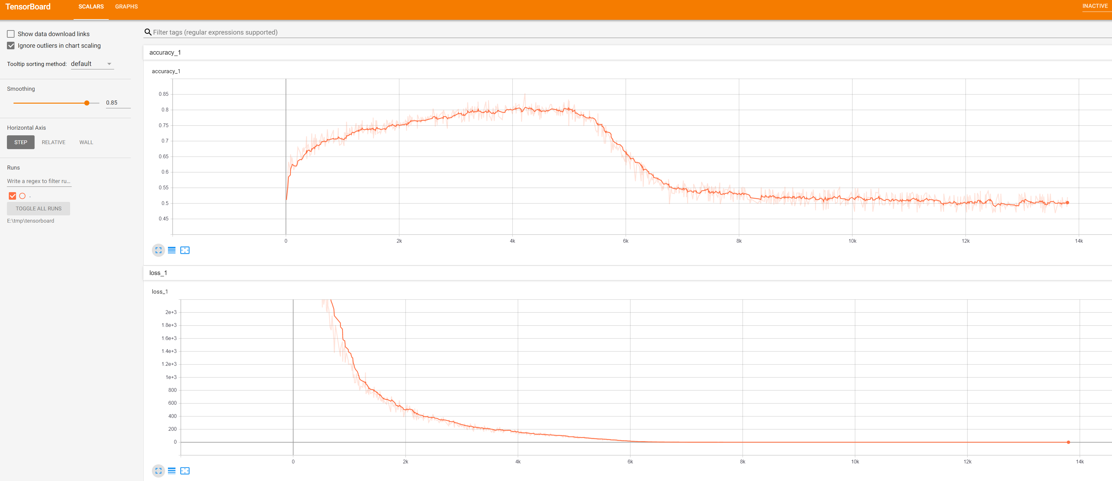
5.1 Construct and show summary of your model structure by printing out on the terminal. (5%)
Fig. Summary of ResNet50
5.2 Training at home at least 5 epochs and use TensorBoard to monitor, then save the final screenshot of TensorBoard (5%, Use other tools can get 3%).
Fig. Example of training with TensorBoard

Slide 22
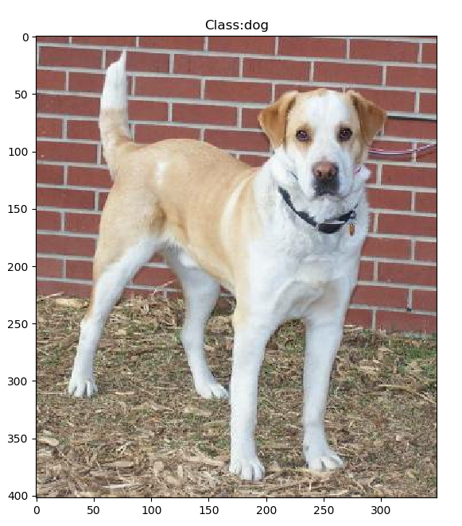
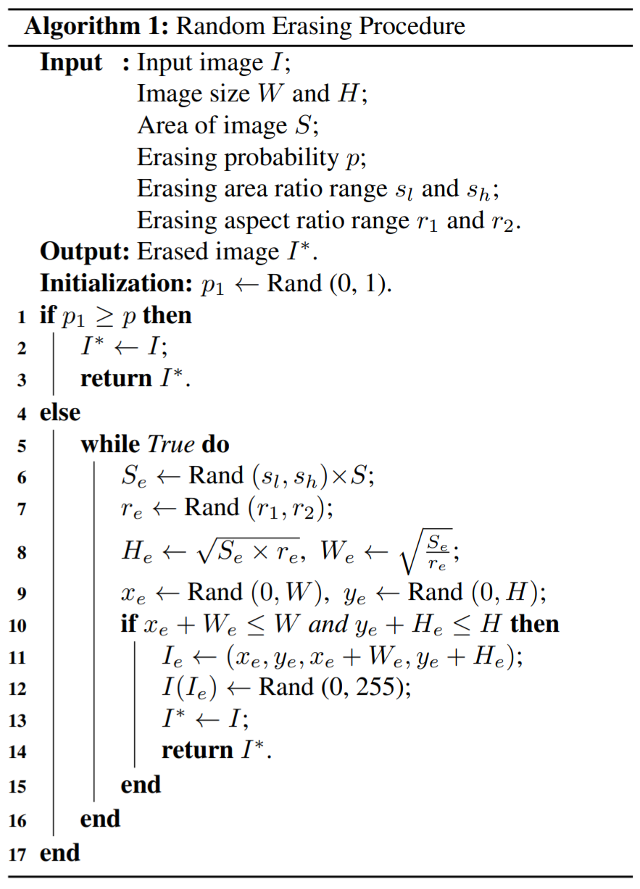
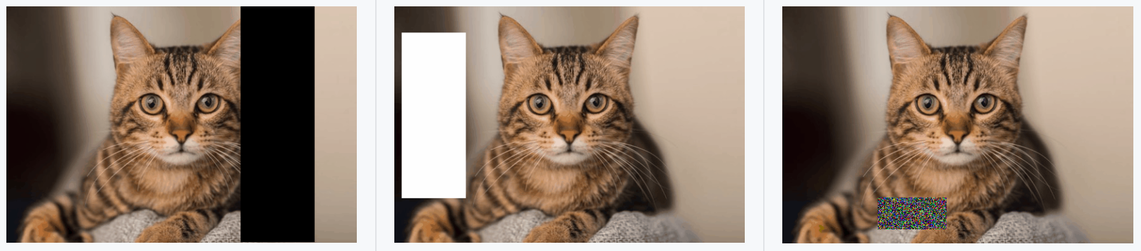
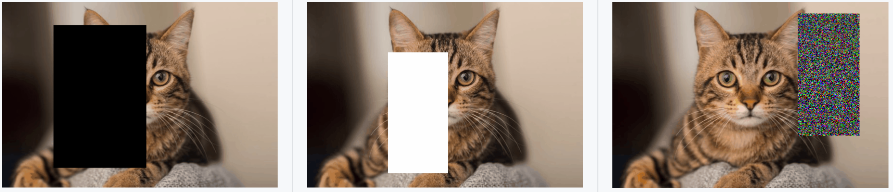
5.3 Randomly select a picture from the test set and mark its predicted category.(5%)
Fig. Classification display example
Fig. Random-Erasing algorithm
5.4 Train another model with Random-Erasing or any other data augmentation method. Write the code of your augmentation method(3%) and draw the comparison table of accuracy, save it as a picture.(2%)
Accuracy
Fig. Examples of the use of Random-Erasing
Fig. Random-Erasing effect comparison example
R. Reference
Random Erasing Data Augmentation

